Slide 1
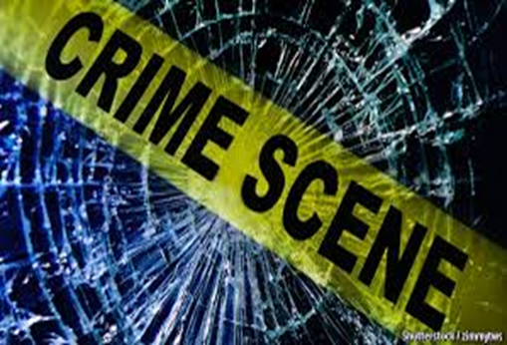
Crime & Punishment

Slide 2
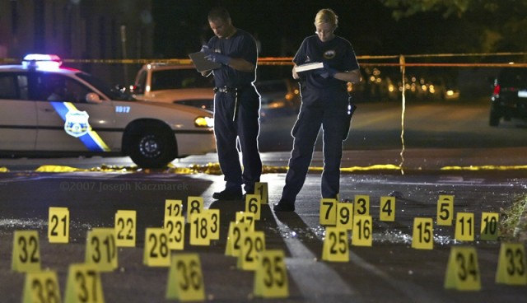
Crime & Criminal Law
Criminal law, a.k.a. substantive law, is the law of crimes

Slide 3
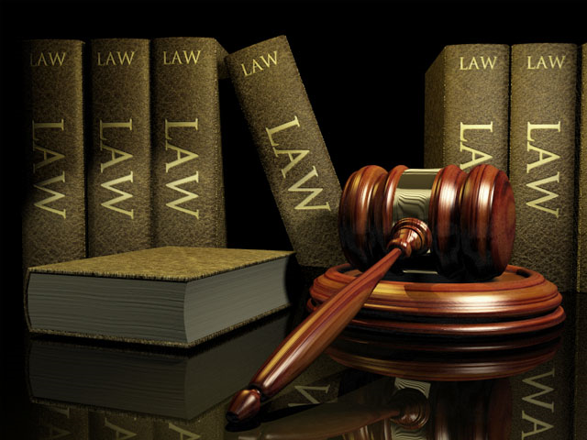
Defined by statute
a written law passed by a legislative body

Slide 4
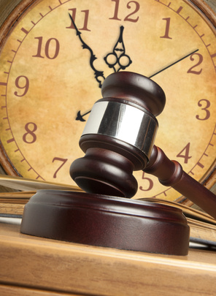
Prescriptions
almost all lawsuits must be started within a legally decided period

Slide 5
if they are reported after that time, an institution called prescription applies, which prevents them from filing the case
Enforced by the state

Slide 6
Primary purpose is to protect the public from harm by punishing harmful acts that have occurred and seeking to avoid harm by forbidding conduct that may lead to it

Slide 7
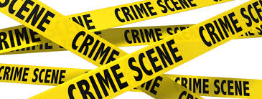
What Is Crime?
“[A]n intentional act in violation of the criminal law committed without defense or excuse, and penalized by the state”

Slide 8
The person committing this action must have intended to do so
to have done so without any legally acceptable defenses or justifications

Slide 9
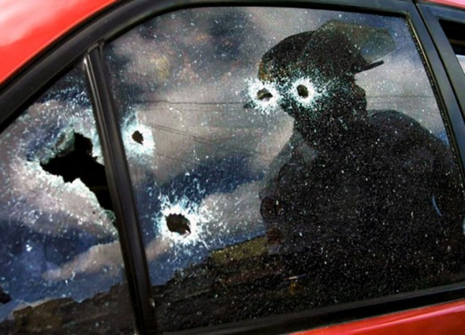
Intro to Criminological Theory
Several theories attempt to explain criminal behavior

Slide 10
Some theories assume
Crime is part of human nature
Crime is based on biological, psychological, sociological, and/or economic aspects

Slide 11
Classical Theory
Early approach to explaining the causes of crime.

Slide 12
A product of the Enlightenment, based on the assumption that people exercise free will and are thus completely responsible for their actions

Slide 13
In classical theory, human behavior, including criminal behavior, is motivated by a hedonistic rationality, in which actors weigh the potential pleasure of an action against the possible pain associated with it

Slide 14
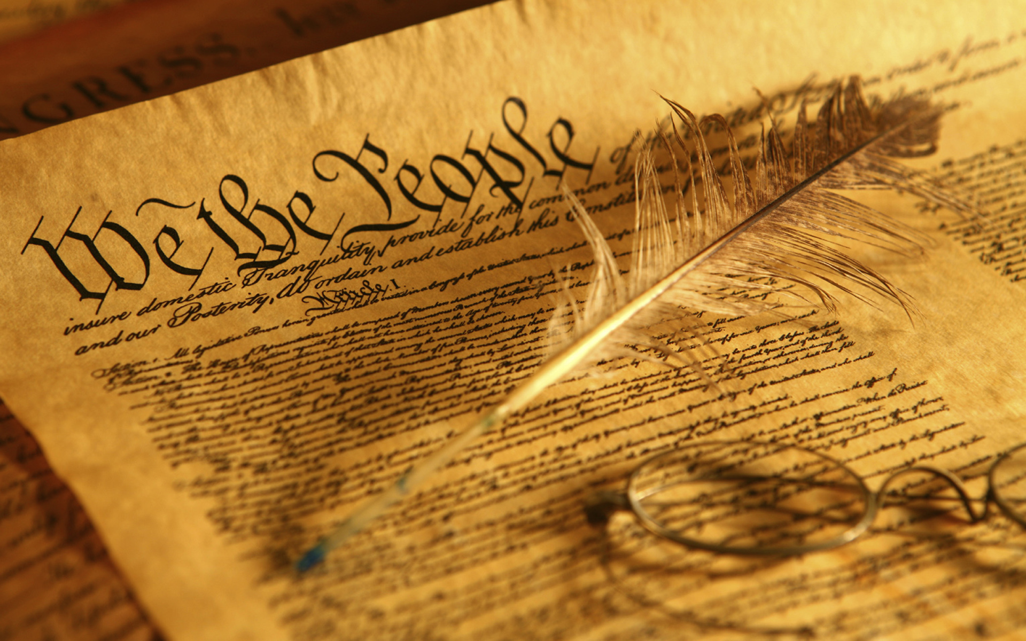
Sources of Criminal Law
State and federal constitutions
State and federal statutes

Slide 15
Common law
codified in most states mid-1800s
Statutes define elements (various parts) of a crime more specifically than common law

Slide 16
So people know how to act towards each other
To protect the weak from the strong and to allow people to live in safety and order
Reasons why are
laws needed
Laws allow people to feel safe and secure
To keep control of society and avoid chaos and accidents e.g speeding

Slide 17
But are there times when laws need to be broken?
What about when it is an emergency?
What about when some laws are unfair?

Slide 18
Why We Need Justice
Justice means that fairness happens to all. If someone does something wrong it means that they and the rest of society are treated fairly

Slide 19
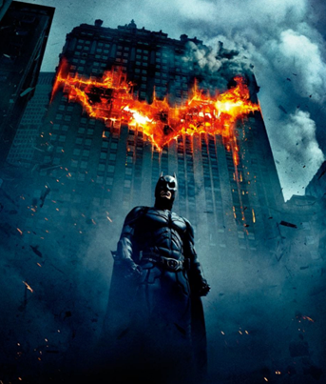
If the law was unfair to society then people may break it

Slide 20
If punishments are unfair by being too lenient then it can lead to vigilantism – people take the law in to their own hands which is unfair as it often goes too far
https://www.youtube.com/watch?v=-NHk869YUqo

Slide 21
The Theory of Punishment What some people think punishments should be about
Deterrence
If we punish harshly enough, it will put other people off doing the same crime
Retribution
It should be about making someone pay for what they have done, and be seen by others to be punished
Purposes
of Punishment
Reparation
Using punishment to allow a criminal to make right their wrong to their victim or to society. Community service is an example of this
Protection
Prison etc takes the dangerous people out of society and so keeps everyone else safe
Reform
Punishment should be about trying to make a person realised that what they did was wrong and make them never want to do it again

Slide 22
But what are the problems with these theories behind punishing?
Deterrence
Some crimes are in the heat of the moment, so the consequences are not thought about
Retribution
But does this work as well for someone who assists someone with voluntary euthanasia?
Purposes
of Punishment
Reparation
How can a murderer or drink driver make amends to their victim’s family?
Protection
Not all crimes are dangerous to the safety of others so this wouldn’t always work e.g a debtor
Reform
How can you tell if someone is reformed? Will society be happy in using tax payers money to pay for a criminal to be retrained as a plumber etc?

Slide 23
Causation
Factual cause: “but for” the actor’s conduct the harm would not have occurred

Slide 24
Legal cause: consequences of an act which are not reasonably foreseeable to the actor (intervening causes) relieve the actor of some degree of criminal liability

